Slide 1
The Background of Nominal Unit shear strength(V_{s}) for shear wall in US standard
Li Rui ＆ Zhao Jianchi
Notes:
Today’s topic is the question that isoda sensei gives us, So I use this as the topic.

Slide 2
Content
Introduction
Specimen
Test setup
Test Procedure
Calculation
Reference
Notes:
I will introduce follow this content, and during my introduce I will make comparison between Japanese Standard with US standard

Slide 3
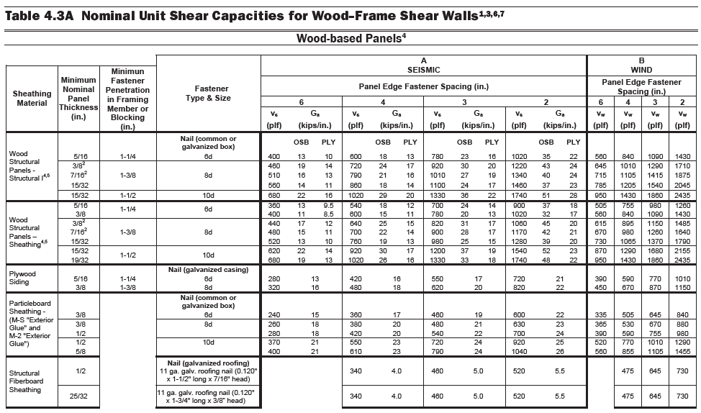

Introduction
1 plf(pound per linear foot)→14.59 N/m
Vs : Tabulated Nominal Unit Shear strength
Determine allowable unit shear strength
Use in Allowable Stress Design method(ASD) and Load Resistance Factor Design method(LRFD)
Notes:
First what is Vs, Vs is a nominal unit shear strength tabulated in SDPWS building standard, it can be used to calculate the allowable unit shear strength by multiplying or dividing some factors. And this allowable unit shear strength will be used in ASD and LRFD design method. The unit of the Vs is pound per linear foot, and can be transferred to KN/m

Slide 4
Introduction
ASTM E2126- Cyclic Load Test for Shear Resistance of Vertical Element of the lateral Force Resisting System for Buildings
Vs
ASTM E564- Static Load Test for Shear Resistance of Framed Walls for Building(basic test for ASTM 2126)
First Major Event (FME)
Ultimate displacement (Δm)
ASTM-American Society for Testing and Materials
Notes:
Vs was tested according to ASTMxxxxxxx, u can see the title of the standard, and the mainly difference is one is xxx the static load. And Static load is used to determine the FEM and Δm. Talking about FEM. Today we mainly focus on the Vs determine method, so we mainly focus on ASTM E2126

Slide 5
Introduction
Example:
Typical 8-ft(2.4-mm) wall
wood-framed walls with wood structural panel sheathing-Aspect ratio (h/b) of 2:1 or less. FME=0.8 in.(20mm); aspect ratio of 4:1, FME= 1.2 in(31mm)
Wood-framed walls with gypsum sheathing-Aspect ratio of 2:1 or less, FME=0.25 in(6.4mm)
First Major Event (FME)
The FEM is the first significant limit state that occurs during the test.
The limit state is an event demarks the two behavior states, at which time some structural behavior of the specimen is altered significantly.
FME is determine by conducting monotonic load test.
Notes:
Vs was tested according to ASTMxxxxxxx, u can see the title of the standard, and the mainly difference is one is xxx the static load. And Static load is used to determine the FEM and Δm. Talking about FEM. Today we mainly focus on the Vs determine method, so we mainly focus on ASTM E2126

Slide 6
Specimens-ASTM E2126
Frame
Panel sheathing
Bracing element
Diagonal bracing
fastening
Type
Tested Shear wall
Connection
Spacing edge distance of fasteners
Spacing of the shear connections and hold-down connectors
Sheathing Panel Attachments
Attachment to the Test base
Notes:
First lets talking about the specimens, as u might know the wood-framed shear wall is influenced by a lot of factors like frame, bracing element…..xxxxx, so each individual wall has its own value of Vs. before we conduct our test we should determine which kind of shear wall we are purposed on. All the material and test setup should representive of those to be used in the actual building construction.

Slide 7
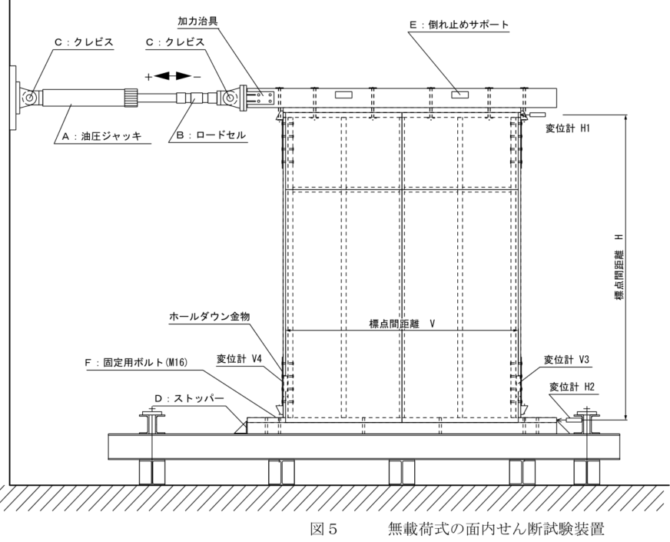
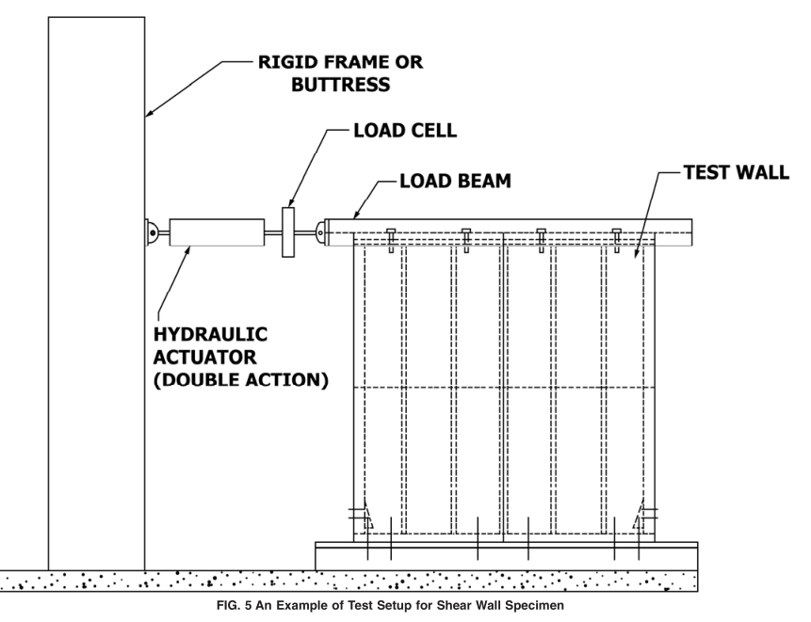
Test setup
Optional horiz. joint
Hold-down
Anchors
（ASTM E2126)
(枠組壁工法耐力壁及びその倍率性能試験・評価業務方法書 日本建築総合試験所）

Slide 8
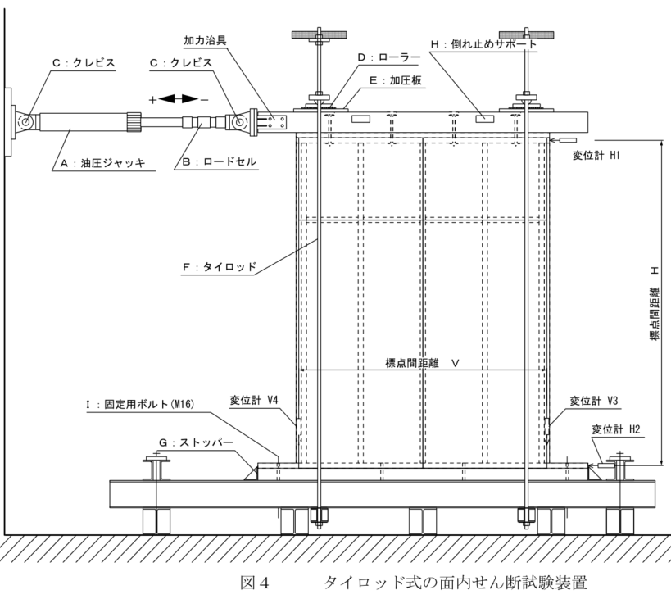
Test setup
If necessary both Japan and US use the tie-rod method

Slide 9
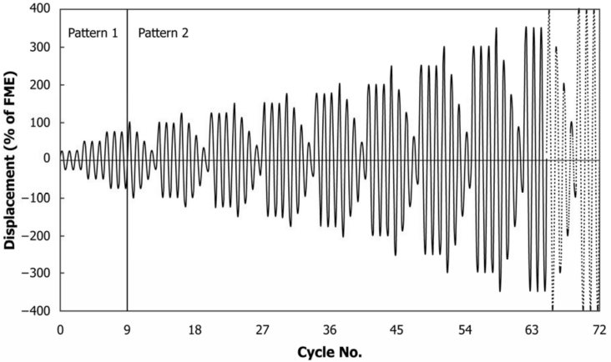
Test procedure-loading method
Method-A SPD method
(Sequential-phased Displacement Procedure)
Consists of two pattern.
The first pattern consists of three phase, at displacements representing 25%, 50%, 75% of anticipated FME.
Notes:
The cyclic displacement of the actuator shall be controlled to follow three kinds of loading method.
The second pattern is also increase 25% of each phase， lets enlarge one phase

Slide 10
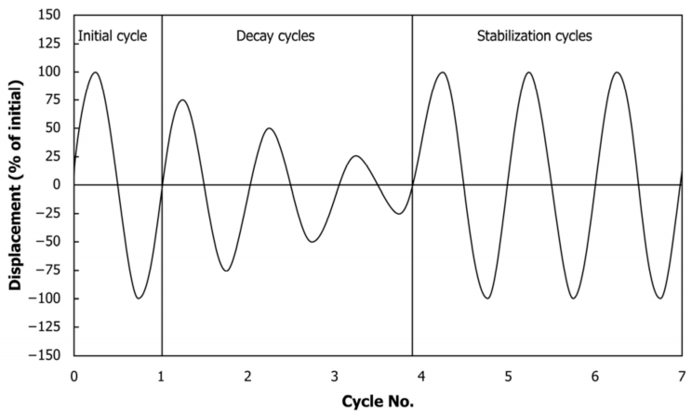
Test procedure-loading method
Method-A SPD method
(Sequential-phased Displacement Procedure)
Each phase of the second pattern contains one initial cycle, three decay cycles, and a number of stabilization cycles. For nailed wood frame walls, three stabilization cycles is enough.
The amplitude of each decay cycle decreases by 25% of initial displacement.

Slide 11
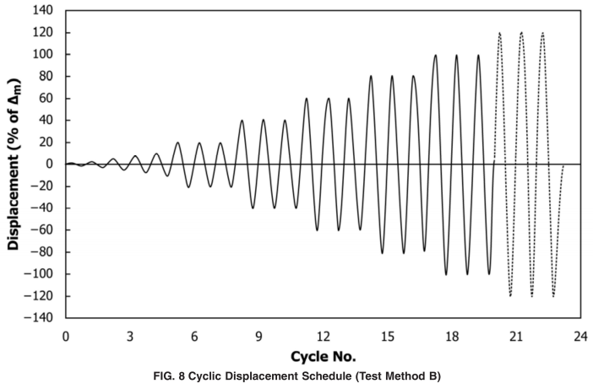
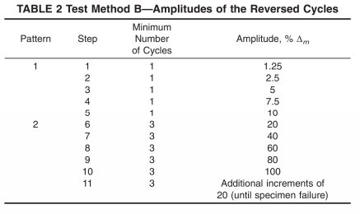
Test procedure-loading method
Method-B ISO method
ISO Displacement Schedule includes 2 patterns
The first displacement pattern consists of five single fully reversed cycles at displacements of 1.25 %, 2.5 %, 5 %, 7.5 %, and 10 % of the ultimate displacement ∆ m .
The second displacement pattern consists of phases, each containing three fully reversed cycles of equal amplitude, at displacements of 20 %, 40 %, 60 %, 80 %,100 %, and 120 % of the ultimate displacement ∆m

Slide 12
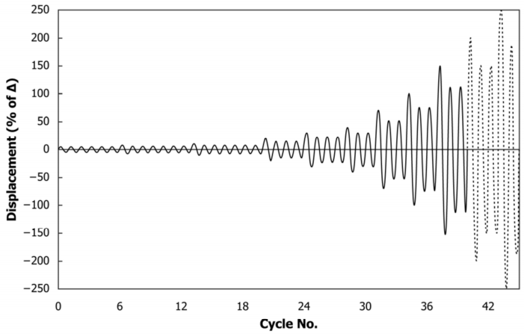
Test procedure-loading method
Method-C CUREE method
CUREE involves displacement cycles grouped in phases at increasing displacement levels.
Starts with a series of initiation cycles at small, equal amplitudes.
Then, each phase of the loading consists of a primary cycle with amplitude expressed as a fraction of the reference deformation and subsequent trailing cycles with amplitude of 75% of the primary one.

Slide 13
Test procedure-loading method
Method A vs Method B
Method A maybe applicable when Fme is the yield limit state or for testing slack systems to determine a lower bound displacement causing hysteretic energy dissipation
Method B may be more applicable to systems that exhibit linear elastic behavior where FME is the strength limit state. If the ratio of Δm and FME is less than three, Method B may be preferable
Method C
The latest method。
For me now is a mystery

Slide 14
Test procedure-loading method
There are two loading methods in Japanese standard.
First one is used in tie-rot type.
Each phase of that procedure consists of three fully reversed cycles, associating with a respective displacement level of 1/600, 1/450, 1/300, 1/200, 1/150, 1/100, 1/75, 1/50rad.
When it comes to the maximum load stress , continue loading until deformation angle comes to 1/15 or load stress decrease to 80% of the max load stress.
The second method is for no tie-rot type.
Each phase of this method also consists of three fully reversed cycles, and associates with a respective displacement level of 1/450, 1/300, 1/200, 1/150, 1/100, 1/75, 1/50rad.
When it comes to the maximum load stress , continue loading until deformation angle comes to 1/15 or load stress decrease to 80% of the max load stress.

Slide 15
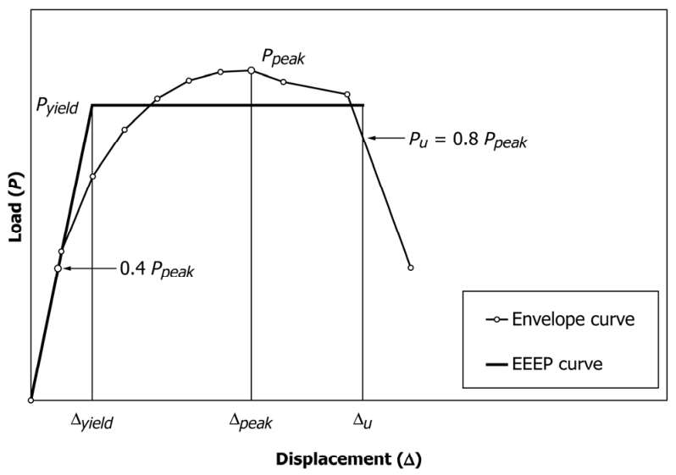
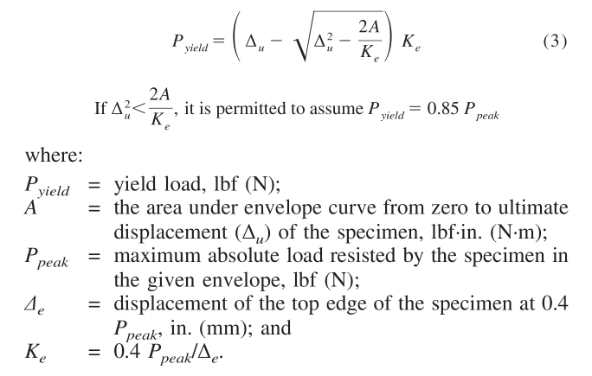
Calculation
Failure limit state----Δ_{u}(in cyclic test), Δ_{m} (in monotonic test)
Strength limit state----Δ_{peak，}P_{Peak}
Yield limit state----Δ_{yield}, P_{yield}
Notes:
Envelop curve is determined using load-displacement data from the test, Py

Slide 16
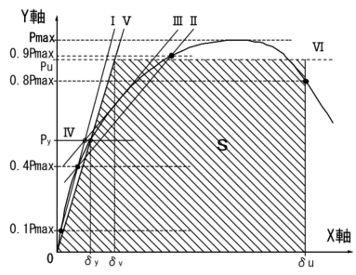
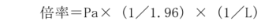


Calculation
Allowable strength Pa
Shear strength(V_{peak})
Py
$$V_{peak}=\frac{P_{peak}}{L}$$
0.2Pu($\sqrt{(2μ−1)})$
Pa
P_{peak}= maximum load resisted by the specimen in the given envelope, lbf(N); and
L = length of specimen, ft(m)
unite ----- lbf/ft or N/m
2/3Pmax
P1/120 or P2/150
P_{max}= maximum load resisted by the specimen in the given envelope; N; and
P_{u}=Ultimate strength, N ; and
u = yield ratio calculated Du divided Dy multiplied by Pu/Py
Vpeak is the tabulated design value in US standard
倍率 is the tabulated unit design value in Japanese standard
Notes:
0.8pmax or displacement corresponding to 1/15

Slide 17
Reference
ASTM E2126-11 Standard Test Method for Cyclic (Reversed) Load Test for Shear Resistance of Vertical Elements of the Lateral Force Resisting Systems of Buildings
木造軸組工法住宅の許容応力度設計（２００８年版）
枠組壁工法耐力壁及びその倍率性能試験・評価業務方法書

